Slide 1
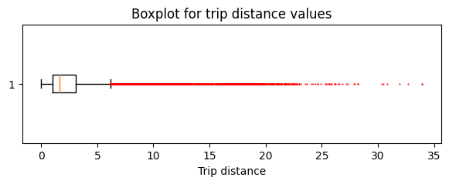
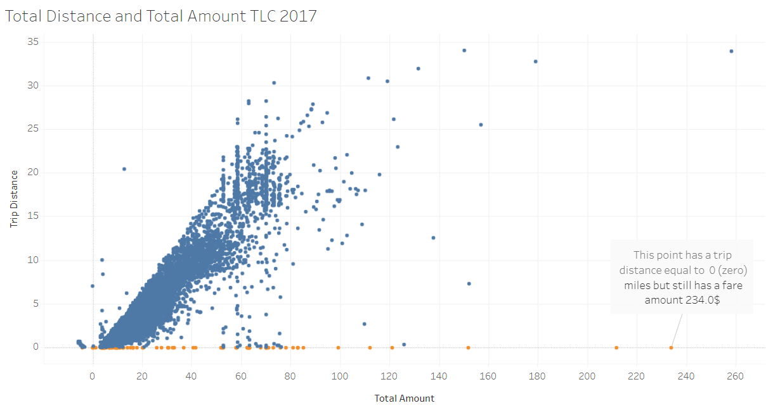
New York City TLC Project . Exploratory Data Analysis. Executive summary
Executive summary report
New York City Taxi and Limousine Commission (TLC) requested to build a regression model that predicts taxi cab fares before each ride. based on distance, time of day, and any additional variables we find necessary. At this stage, Data Team should perform Exploratory Data Analysis and provide detailed inside about findings
The highest distribution of trip distances are below 5 miles, but there are outliers all the way out to 35 miles.
The total cost of each trip also has a distribution that skews right, with most costs falling in the $5-15 range.
Monthly rides are fairly consistent, with notable dips in the summer months of July, August, and September, and in February.
Wednesday through Saturday had the highest number of daily rides, while Sunday and Monday had the least.
Thursday had the highest gross revenue of all days, and Sunday and Monday had the least.
Saturday had only 35 fewer rides than Thursday, its gross revenue was ~$6,000 less than Thursday's - more than a 10% drop.
Image Alt-Text Here
Use descriptive statistics to learn more about the data.
For negative fare amount – drop this data
For zero distance trip – request explanations, drop if none
Create and run a regression model.

